Slide 1
Softwares & Tools for SNU_AO class
Yoonsoo P. Bach

Slide 2
Contents
IRAF and SAOImage ds9
Python in Astronomy

Slide 3
IRAF and SAOds9
Brief history and problems of IRAF

Slide 4
Situation After CCD
In 1970s, many observatories changed from photoplates to CCDs.
Photoplate: visual inspection to get magnitudes
CCD: computer (digital devices) needed.
Computer programs needed.
Melting-pot of CCD reduction programs
STARMAN, POORMAN, DAOPHOT, ROMAFOT, WOLF, HAOPHOT, …
We (they) needed a unified system.
IRAF (US): 1981 – 1986 (design), 1986 – 2012 (NOAO), 2019 – (community ed.)
Starlink Project (UK): 1979 – 2005. Maintained 2006 – 2017?
Starlink, 1999

Slide 5
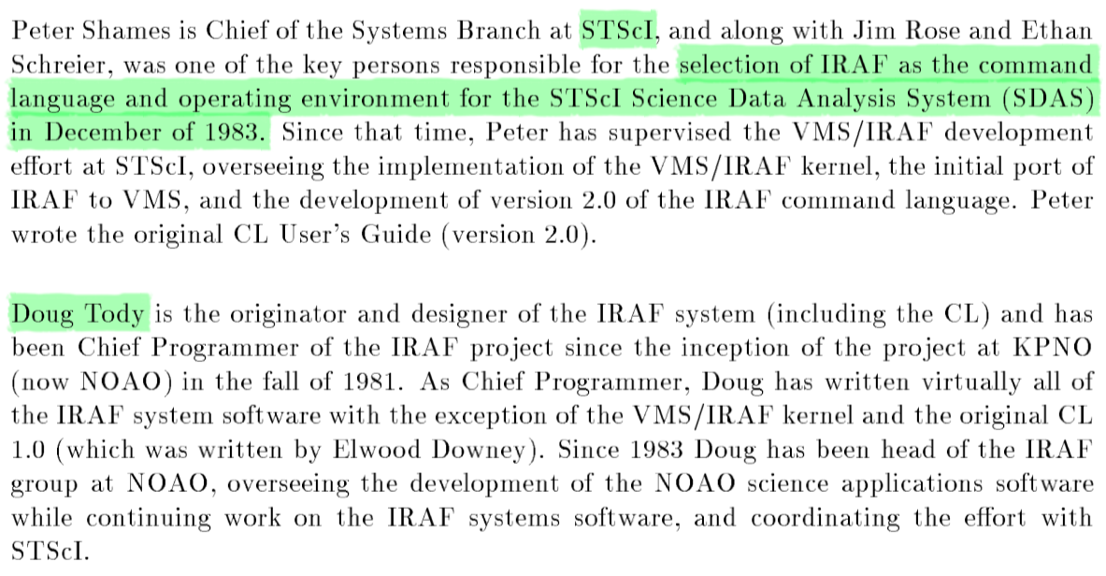
IRAF
Image Reduction and Analysis Facility
STScI (The Space Telescope Science Institute)
STScI selected IRAF as their scientific core language.
35 years later, they suddenly removed IRAF from their history, which is a very irresponsible action
A User's Introduction to the
IRAF Command Language Version 2.3
Revised 1986-08-11

Slide 6
IRAF
The latest official IRAF version was 2.16.1 in 2012.
Important notes:
No official update will be there after 2.16.1.
NOAO and AURA dropped any support for IRAF.
STScI dropped support for IRAF since mid 2010s.
Basically a UNIX-based command line tool.

Slide 7
SAO ds9
SAOImage: developed in 1990 by Mike van Hilst (@ SAO, CfA, Harvard University).
First for X10 then reimplemented to X11 (one of first X11 based free apps in the world!)
Mid-1990s: Integration to IRAF, make interaction possible (see next slide)
1998: NASA funding from "Future Directions for Astronomical Image Display", DS9.
Currently(?) funded by NASA High Energy ~~ and Chandra X-ray Science Center.
Now maintained by Jessica Mink (WCSlib maintainer)
Smithsonian Astrophysical Observatory (SAO)
@ Cambridge, Massachussetts
For details, see http://ds9.si.edu/doc/story.html

Slide 8
IRAF + DS9
Strong points
Fast interactions with SAO ds9.
Python cannot beat it. Unfortunately.
Put your mouse on an image, hit keyboard, it prints scientific results.

Slide 9
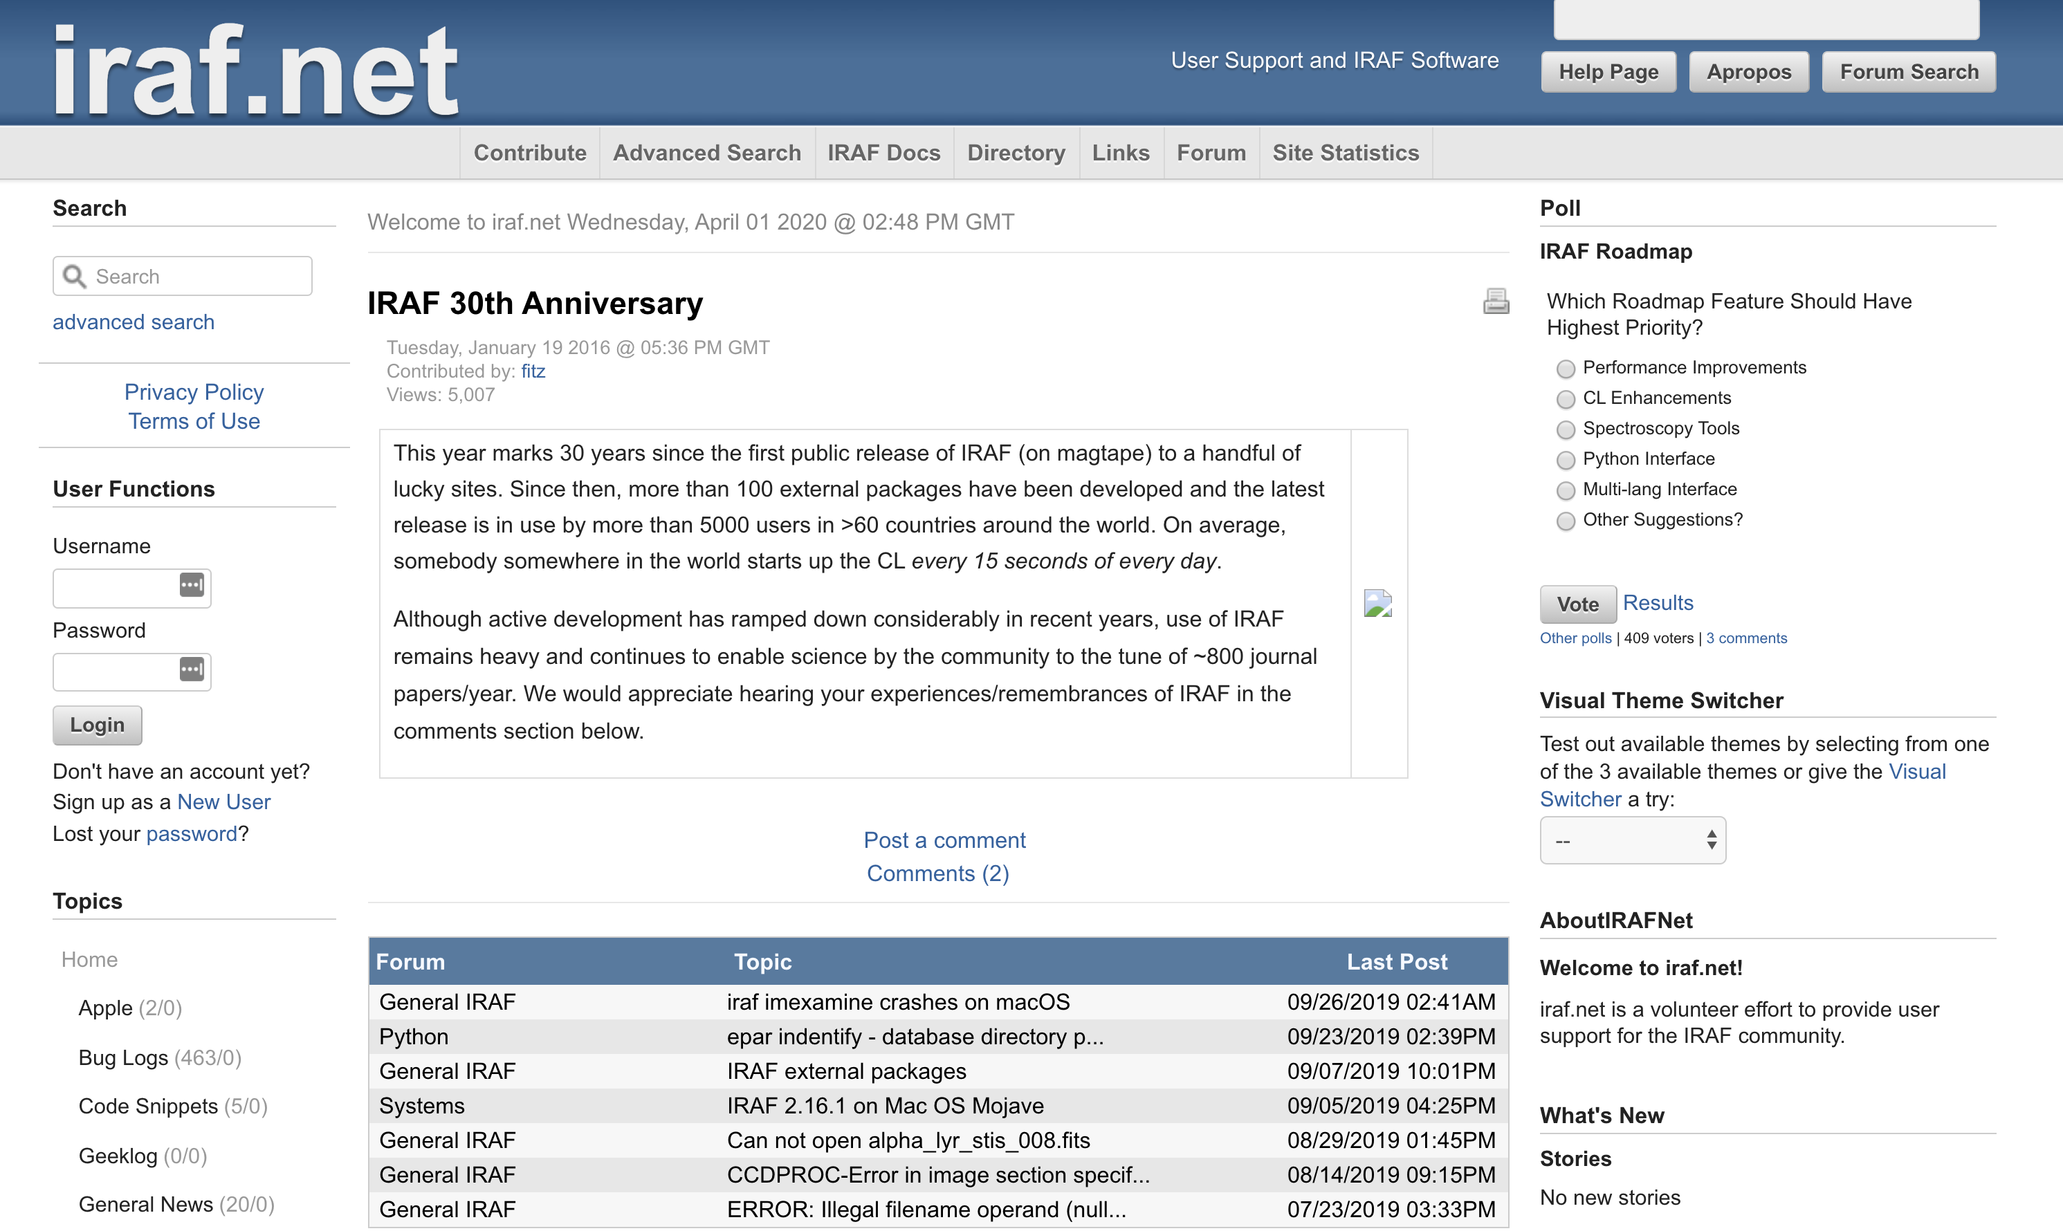
IRAF Problems – (1) No Support
There is no official support for IRAF now… All removed.
iraf.net = personal blog by an IRAF developer, Mike (Michael) Fitzpatrick.

Slide 10
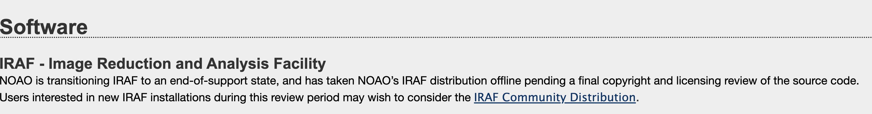
IRAF Problems – (1) No Support
Since mid-2010, all astronomical communities started phasing out IRAF support.
NOAO declared end-of-support:
STScI also declared so (see next slide)
http://ast.noao.edu/data/software (NOAO, 2020-04-01)

Slide 11
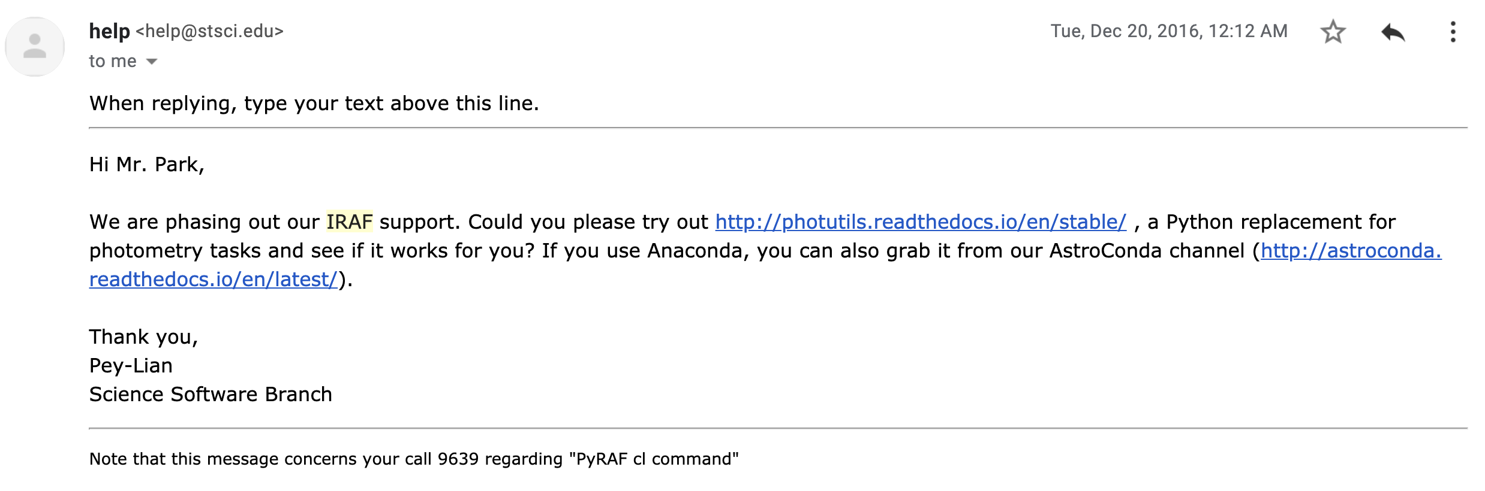
IRAF Problems – (1) No Support
… I am sending an email to ask about the error or bug I am having. I wanted to do a photometry by manual code: phot image.fits coords=image.fits.coo.1 output=image.fits.mag.1 interac=no cbox=5 annulus=10 dannulus=10 aperture=5 verify- verbose- When I do this, I realized that the resulting image.fits.mag.1 file has RAPERT=3, not 5. RAPERT of 3 is the default setting of PHOT task, so I think the above cl script does not touch (and change) the parameter setting of PHOT. The same command works fine and outputs the result with RAPERT=5 in ecl of IRAF.
Is there anything I missed? One possible way to circumvent this problem is that I can write a multi-line code which approaches PHOTPARS and CENTERPARS, as well as PHOT, but that is bothersome. Also I have ~1000 images and PyRAF does not accept code with 1000+ lines (by default), so I want to make only one line per each file.
STScI Pey-Lian Lim,
2016-12-20

Slide 12
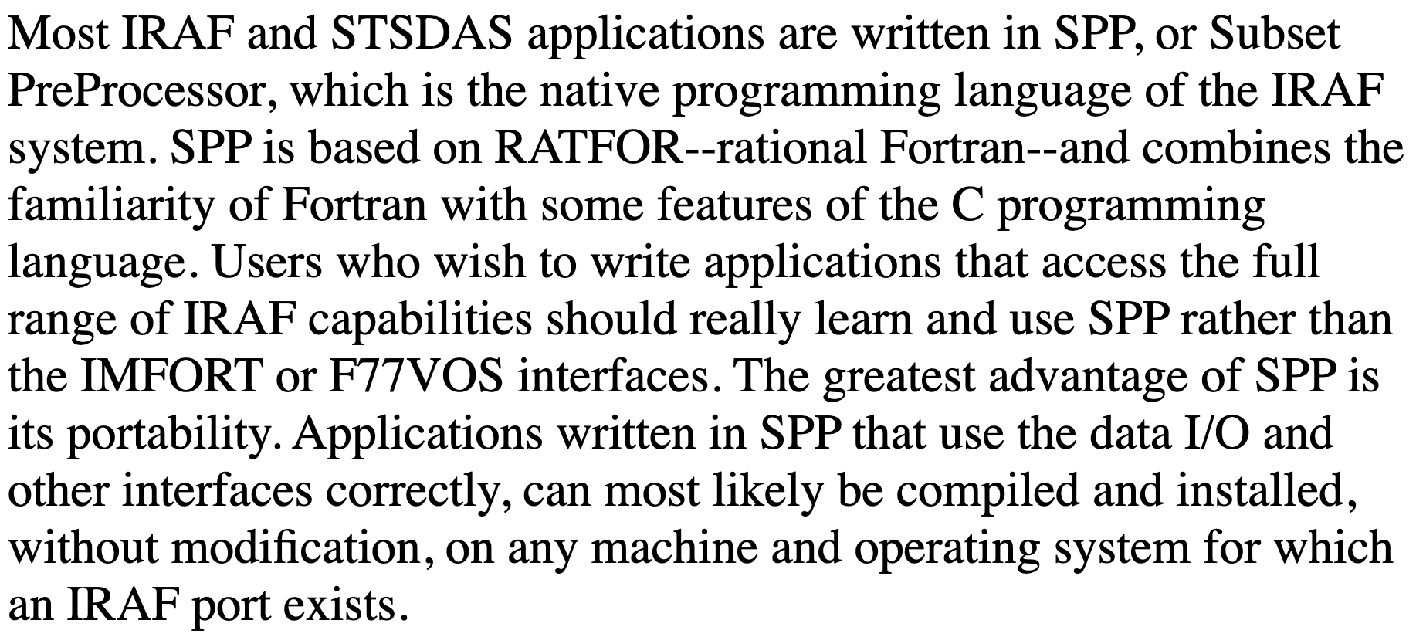
IRAF Problems – (2) Programmer's View
It's an old program uses its own preprocessed language.
It uses SPP. Virtually no one in the world now can update it.
Easiest way to hack astronomer's computer?
Develop elementary hacking tools targetting memory used by IRAF (?).
All parts important for modern language are missing
related to debugging, memory issue, security, …
It even uses 32-bit, and no plan to support 64-bit.
http://stsdas.stsci.edu/documents/SPP/SP_4.html
(emphases added)
http://stsdas.stsci.edu/documents/SUG/UG_51.html
The SPP language is based on the Ratfor language. Ratfor, in turn, is based on Fortran, with extensions for structured control flow, etc. The lexical form, operators, and control flow constructs are identical to those provided by Ratfor. The major differences are the data types, the form of a procedure, the addition of inline strings and character constants, the use of square brackets for arrays, and the task statement. In addition, the SPP I/O facilities provided are quite different and are tailored to the IRAF environment. The syntax of the SPP language is fairly straightforward and fundamentally similar to most other high-level languages. While it is based on the Ratfor language, there are elements of C as well as elements of Fortran. SPP is a preprocessed language. That is, there is no SPP compiler per se, but it is translated into another compilable language. In fact, SPP is first translated into Ratfor, which is processed into Fortran. The xc compiler performs all preprocessing, compilation, and linkage.

Slide 13
IRAF Problems – (3) Licensing?
It seems like IRAF illegally used copyrighted (non-redistributable) code lines.
See iraf.net thread and IRAF community edition Wiki page
Also Ubuntu Debian Bug report logs
https://iraf.net/forum/viewtopic.php?forum=4&showtopic=1468264
https://github.com/iraf-community/iraf/wiki/License-problems-in-IRAF
https://bugs.debian.org/cgi-bin/bugreport.cgi?bug=690531
I don't want to go into the details as it can be legally sensitive issue, but it does have potential to cause critical problems, as IRAF was supported by too many public organizations and national institutions (including NASA and NOAO).

Slide 14
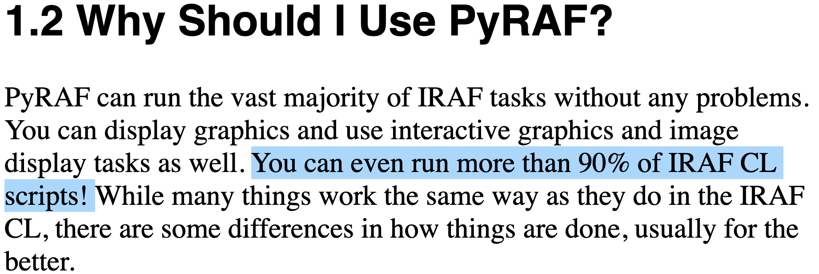
IRAF Problems – (4) Failure of PyRAF
Skeleton identical to IRAF.
Started since 1998 @ STScI; see arXiv article for details.
STScI recommended PyRAF over IRAF in 2000s.
Just running IRAF by Python commands rather than terminal command line.
Serious problems:
Python 2. No plan to reimplemented to Python 3.
Identical script gives different results compared to IRAF (see emails I sent to STScI in 2016).
It didn't even give any error messages and ran as if it does what I told.
"You can even run more than 90% of IRAF CL scripts!"
⬄ "You can get strange results for about 10% of the cases!"
Critical for any professional work:
I had to delete all my PyRAF codes and redo
my data reduction for my research in late 2016.
https://arxiv.org/abs/1610.03159
Of course debugging gets easier when you use PyRAF.
http://stsdas.stsci.edu/pyraf/doc.old/pyraf_tutorial/PythonPrereq.html

Slide 15
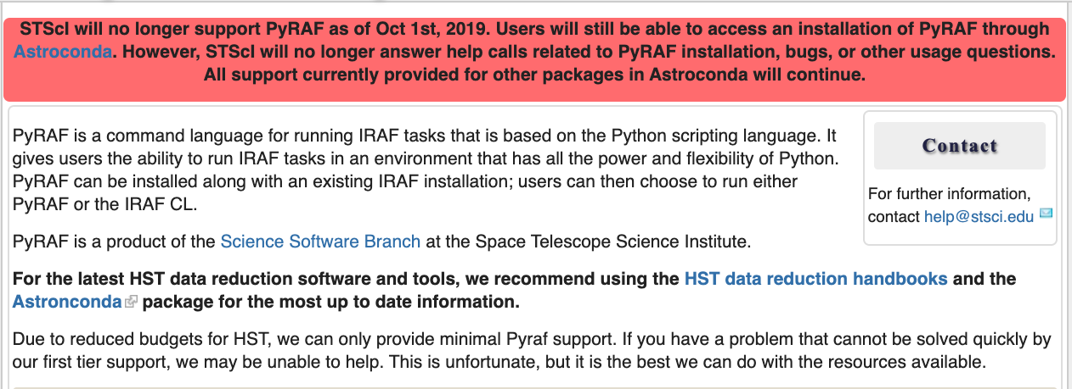
IRAF Problems – (4) Failure of PyRAF

Slide 16
IRAF Problems – (5) Missing Documentations
As of mid 2019, when STScI dropped IRAF support, they removed all online docs.
2019-11-14 18:51 EST - Guest^{Additional comments}
To Whom It May Concern, Hi I am a graduate student. Although I have not using IRAF for 2-3 years for my research, IRAF documentations have been a priceless resource to benchmark
(both scientific and technical sense). Recently, I found all the IRAF documentations such as this one http://stsdas.stsci.edu/cgi-bin/gethelp.cgi?implot are not available. Can I ask where those are located? If they'll not be available through STScI, I want to ask if there's any backup/cached version, because many of my research or teaching-related materials heavily depending on IRAF doc (not IRAF itself). Thanks. Regards, Yoonsoo Bach
2019-11-15 10:59 EST - Pey-Lian Lim^{Additional comments}
Hi Mr. Bach, STScI has dropped IRAF support (also see http://www.stsci.edu/contents/newsletters/2018-volume-35-issue-03/removing-the-institutes-dependence-on-iraf-you-can-do-it-too), which unfortunately includes hosting its documentation. You can try other hosts; e.g., http://iraf.noao.edu/scripts/irafhelp?implot We apologize for any inconvenience caused. Sincerely, Pey-Lian Data Analysis Tools Branch

Slide 17
IRAF Problems – (5) Missing Documentations
As of mid 2019, when STScI dropped IRAF support, they removed all online docs.
Hi!
Thank you so much for the reply. I have two more questions.
1) Is there any backups of the documentations as STScI provided (maybe in html format)?
2) Do you have any code (e.g., python) which converts the IRAF .hlp files to modern formats (like html)?
-- If so, could you share these with me?
-- If not, what is the IRAF .hlp format is called? It doesn't seem like original LINUX man page..?
Thank you so much in advance.
Regards,
Yoonsoo
2019-11-22 12:45 EST - Pey-Lian Lim^{Additional comments}
Hi Yoonsoo, Unfortunately, stopping our support of IRAF at STScI also includes its documentation hosting. You can try ask over at https://github.com/iraf-community/iraf
or https://iraf.net/forum/index.php .
We apologize for any inconvenience caused. Sincerely, Pey-Lian

Slide 18
IRAF Problems – (5) Missing Documentations
As of mid 2019, when STScI dropped IRAF support, they removed all online docs.
Their responses crossed the line. Any sane scientist should shout with rage.
A horrible scientific irresponsibility to remove all online docs of once-they-recommended software.
That software (IRAF) has been used as THE virtual standard for all astronomers for 35 years.
They don't even reply to what I asked (back up of the docs)
"iraf-community" they mentioned is run by a volunteer (Ole Streicher); they are not supporting him at all.
"iraf.net" is a personal blog, and many help pages are missing.
So many parts of my lecture notes and personal notes are now filled with broken links.
Sadly, no alternatives yet.
A big lesson:
Never trust anyone when it comes to scientific archiving.
Even STScI, NASA, or whoever. They can play really dirty.
Backup by yourself.
A bitter reality: Science is standing on such a vulnerable ground – a house of cards (砂上樓閣).

Slide 19
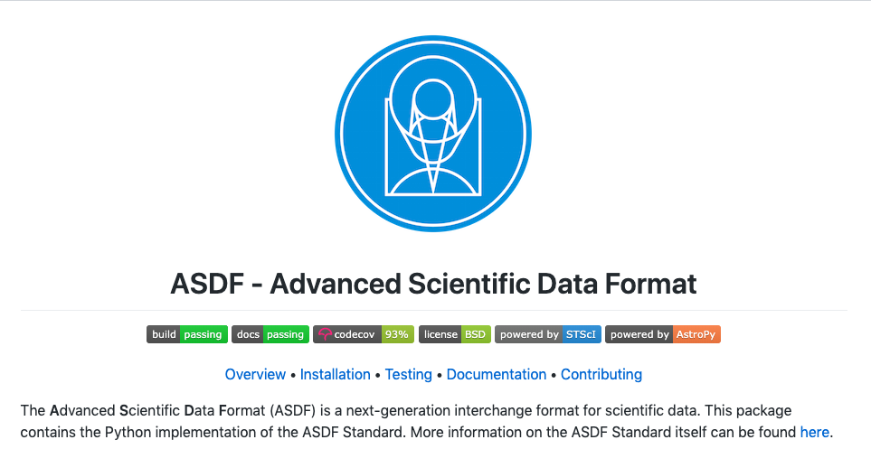
Digression
How can I believe these guys will manage ASDF appropriately? I will rather distrust them.

Slide 20
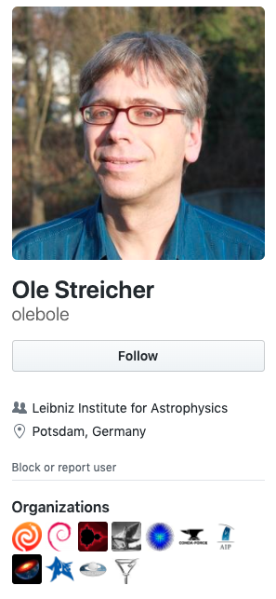
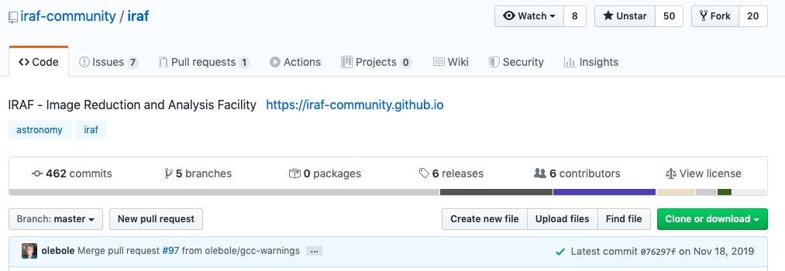
The Current Situation of IRAF
IRAF community edition by Ole Streicher, a volunteer since early 2010s.
Updated IRAF 2.16.1 by more than 400 times to avoid license issues, bug-fixes, etc.
But I guess few professional astronomers know what it is.
https://github.com/iraf-community/iraf

Slide 21
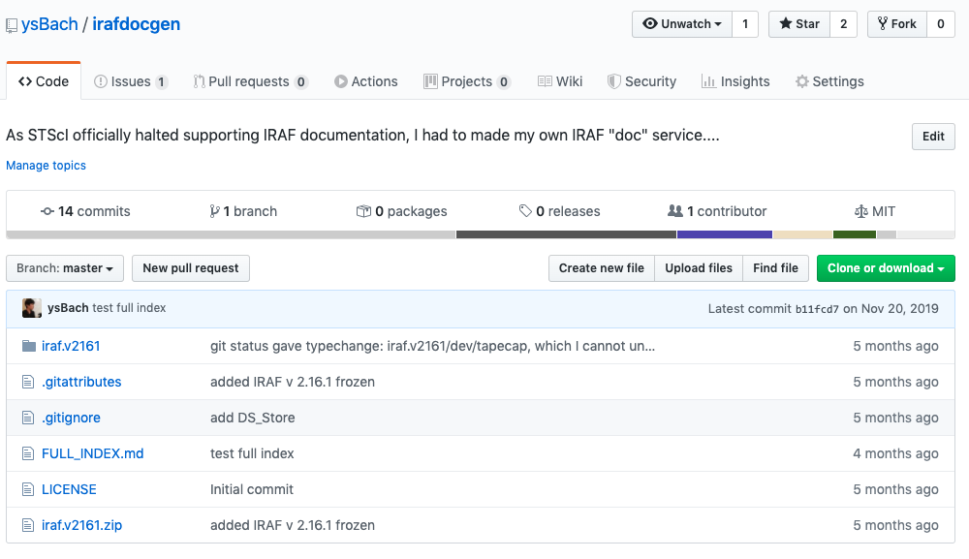
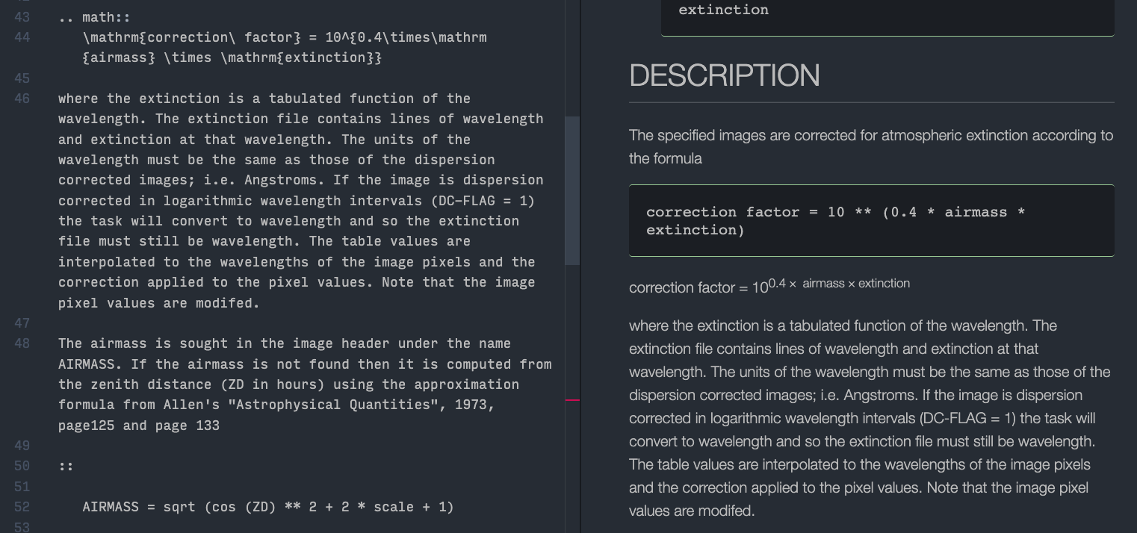
The Current Situation of IRAF
IRAF community edition by Ole Streicher, a volunteer since early 2010s.
Updated IRAF 2.16.1 by more than 400 times to avoid license issues, bug-fixes, etc.
But I guess few professional astronomers know what it is.
I have tried to reconstruct IRAF help docs, but it will take some time (many years?).
https://github.com/ysBach/irafdocgen

Slide 22
IRAF summary
No official support.
Any existing personal supports are not guaranteed (old language, all volunteer, …).
No online documentations on algorithm, task explanations, etc.
Absolutely no plan to be updated substantially.
Legal issues may happen (only a matter of time?).
No Future.
It's rather a sin if I teach IRAF to you. In 2016, when I was teaching IRAF, I felt something's wrong with the atmosphere around IRAF, and realized it is bad to teach it to young researchers who will conduct research in 2020s (yes, it's today). As a young graduate student, who had plenty of time to learn new languages, I started to learn python in late 2016, and discarded nearly all past lecture materials while taking wisdoms from them and have rewritten virtually everything.
NOTE: But SAO DS9 is still the most powerful interactive image diaplayer.

Slide 23
Python in Astronomy
A brief history of the efforts of astronomers who introduced Python to astronomy.

Slide 24
Why Python?
Must be free (no license problem)
IDL is not an option.
Must have future, large community, and be maintained by external experts.
Easy to learn, plenty of learning materials, OS-independent
Python was perfect.
C/Fortran was good but string or file I/O was not as easy as Python. People like high-level languages.
Useful and reliable scientific packages
It became true for Python since mid-2010.
Large facilities already started using Python
LSST, JWST, HST will support python only (with C++).
Of course you can use IDL for analysis, if you have background.
But think this way: will you remain in astronomical field forever? Using python may open up your job opportunity.

Slide 25
Important Packages
astropy: Most basic things for astronomy.
FITS I/O (opening or reading astronomical pictures)
WCS (transformation of pixel coordinate ⬄ RA/DEC, etc)
ccdproc: Basic pre-processing of images
Pre-process loaded FITS files (image combine, bias/dark/flat corrections)
photutils: Basic photometry
Aperture photometry, image segmentation…
astroquery: Load archival data available online
Such as star catalog.

Slide 26
Useful Packages
ysfitsutilpy: My personal package.
Convenience functions for reading CCD, preprocessing, etc.
ysphotutilpy: My personal photometry package
Convenience functions for doing photometry including error-analysis and query.

Slide 27
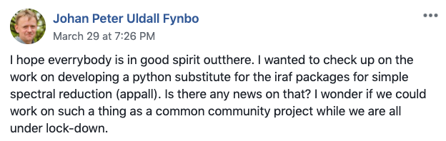
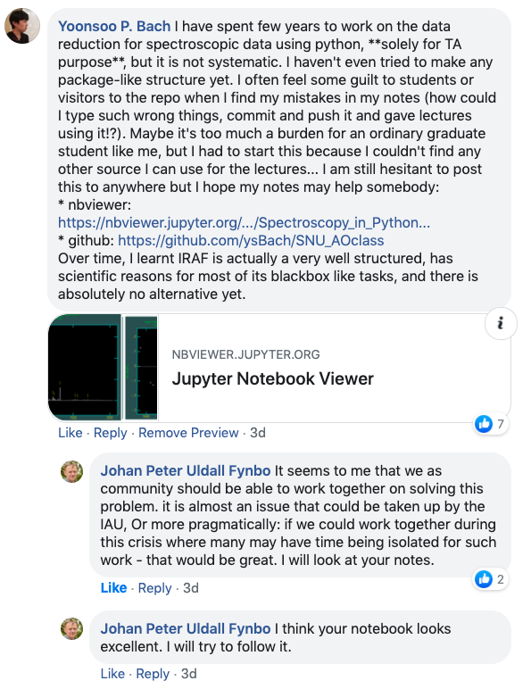
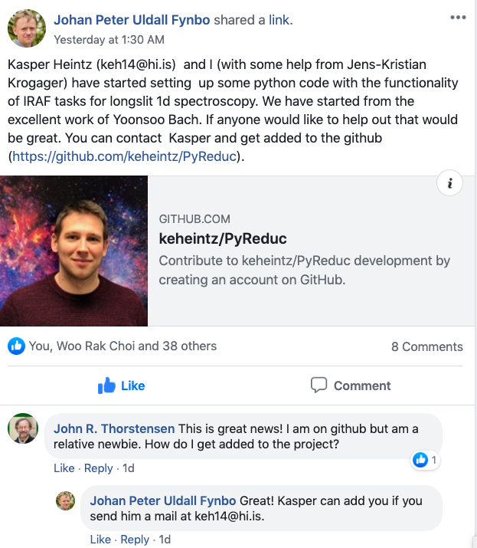
Problems
No available spectroscopic data reduction package yet.
2020 Apr 01

Slide 28
IRAF
V2.2 1985-11-30?
V2.3
V2.4 1986-08-14?
V2.5 1987-Jul?
V2.6 1987-07-08?
V2.7 1988-12-04?
V2.8 1989-06-30?
V2.9 1990-04-10
V2.10 1992-Jul
V2.11 1997-08-27
V2.11.1 1997-12-27 23:21 MST
V2.11.2 1999-Aug
V2.12 2002-01-25
V2.12 2002-01-25 (2002-03-15)
V2.12.2 2004-02-06
V2.12.2a 2004-07-15
V2.13 ?
V2.14 2007-12-01
V2.14.1 2008-09-16
V2.15 2010-11-22V2.15.1 2011-01-25
V2.15.1a 2011-02-21
V2.16 2012-03-22
Version history
From iraf-community/iraf/doc and
from vXX/vXXrevs.txt.Z from
http://iraf.noao.edu/iraf/ftp/
IRAF design phase
1981 Fall
IRAF Project started
1986
IRAF first public release (according to iraf.net)
1990
Python 1
1998
"IRAF must be free"
Python discussion started
1993-03-21
🎂
1981 82 83 84 85 86 87 88 89 90 91 92 93 94 95 96 97 98 99
1980
Starlink started
in the UK
1983 Dec
IRAF selected as STScI script lang
late 1990s
PyFITS developed
Lots of works dealing with statistics, theoretical approach to astronomical CCD data analyses.
Peter Stetson, Steve Howell, Jim Janesick, to name few.
https://github.com/spacetelescope/PyFITS/commits/master?after=e0c7604f35cb2222def581e3422c6f4833602f03+1635
2017 Aug
Starlink fund withdrawn
& became open src
2000 Oct
Python 2.0
2001
Scipy/IPython
2003
matplotlib
2006 Aug
Numpy 1.0
2008 Dec
Python 3.0
2014
Project Jupyter
00 01 02 03 04 05 06 07 08 09 10 11 12 13 14 15 16 17 18 19 20
2000s
NASA started using IDL.
It was used widely among astronomers since 90s
2005
Starlink fund withdrawn
& became open src
2008
Astrophysics by Erik Tollerud
2008 Apr
GitHub appeared
2011-07-25
First commit to astropy
2015 Jan
Astropy 1.0
2018 Jan
Astropy 2.0
2019 Dec
Astropy 4.0
2012 Apr
photutils started
2013 Oct
ccdproc started
https://idlastro.gsfc.nasa.gov/oldnews.html
http://www.eso.org/sci/php/meetings/adass2011/Slides/PDF/All/ADASS_XXI_I04_Fitzpatrick.pdf
https://github.com/astropy/ccdproc/commit/15d12100405c8c8fe45630e29d3b694307452322

